Slide 1
Sherwood Forest Residential
7/5/26 – 8/5/26

Slide 2
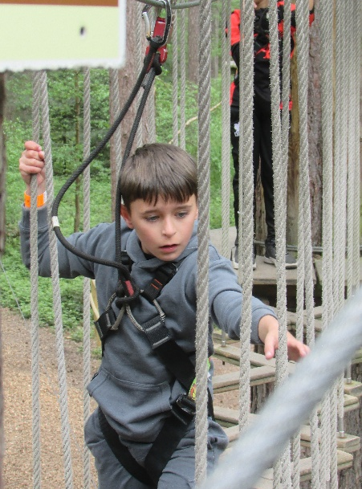
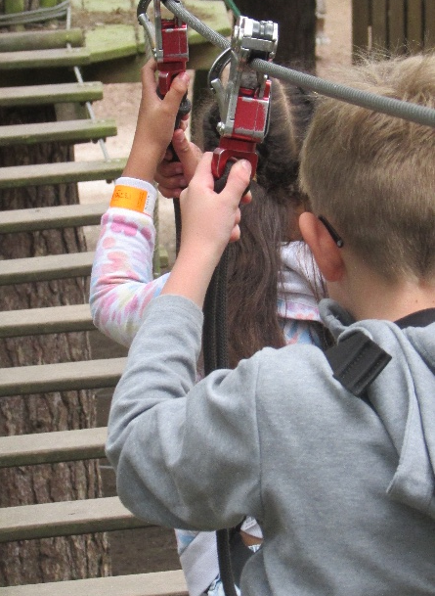
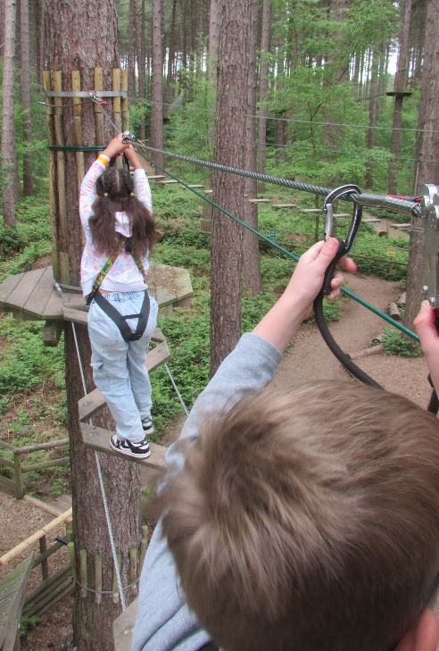

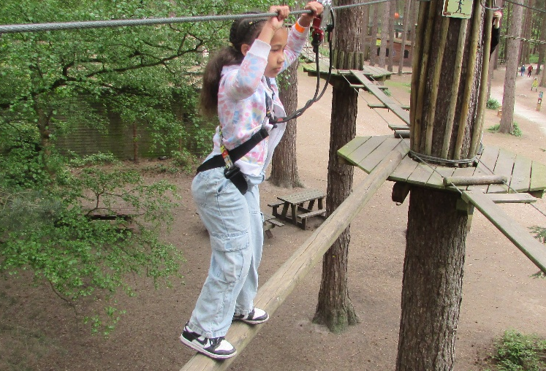
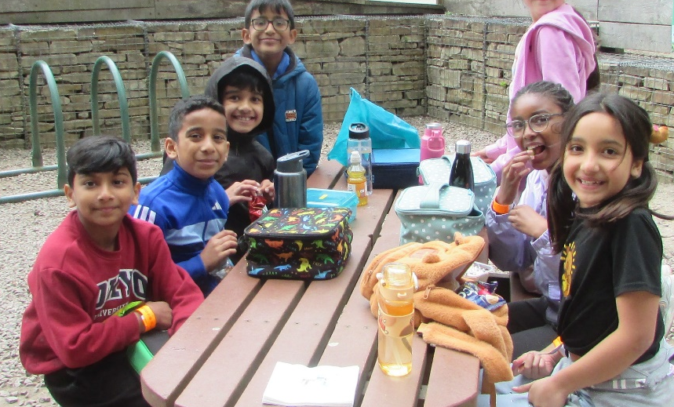
Day One – Part 1
09:30 – Bus leaves Rise Park
10:30 – Arrive at Sherwood Pines
Activity 1 – Go Ape!
In small groups, with help of expert instructors and teachers, we will climb high up into the trees on the exciting high ropes course!
12:30 - Packed Lunch Picnic
Activity 2 – Forest Exploration
Exploring Sherwood Pines, following trails, creating games and making memories!
15:00 – Bus to Sherwood Youth Hostel

Slide 3
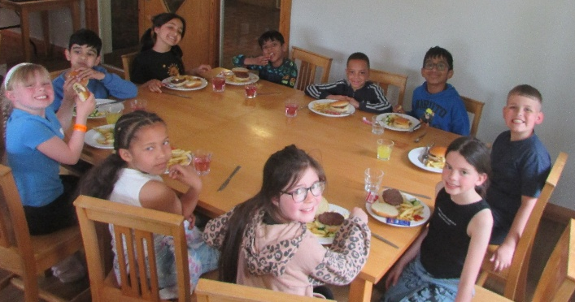
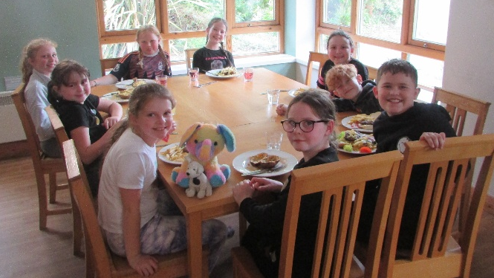
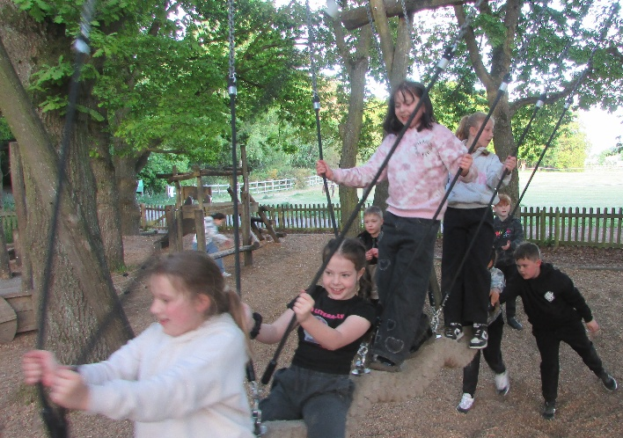
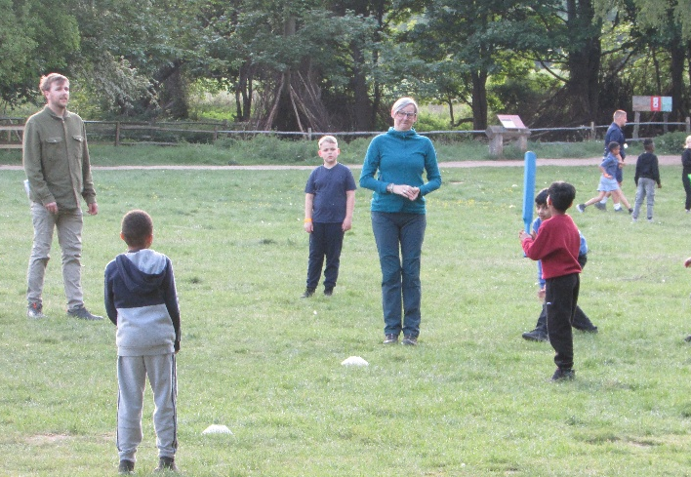
Day One – Part 2
16:00 – Arrive at Youth Hostel
Room allocation, unpack, settle in
17:00 – Dinner Time
18:00 – Forest Walk / Games & Den Building
20:00 – Hot Chocolate, colouring and story time
21:30 – Lights Out

Slide 4
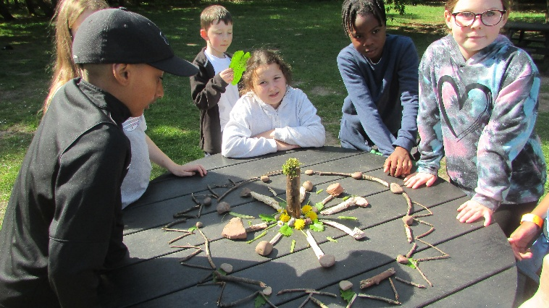
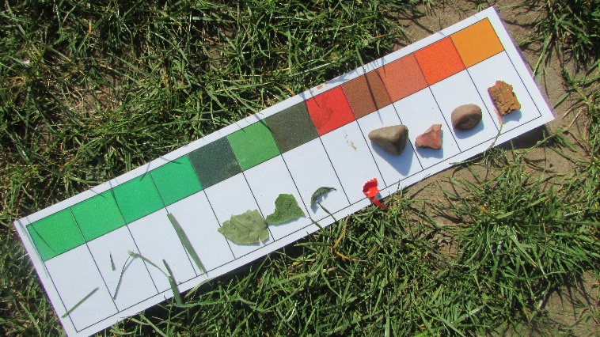
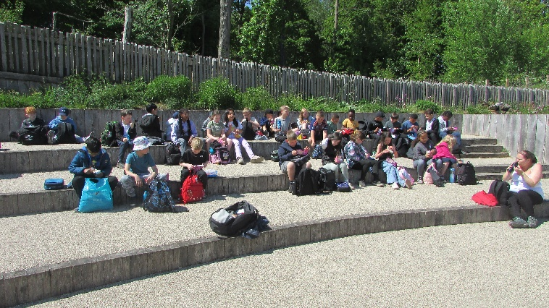
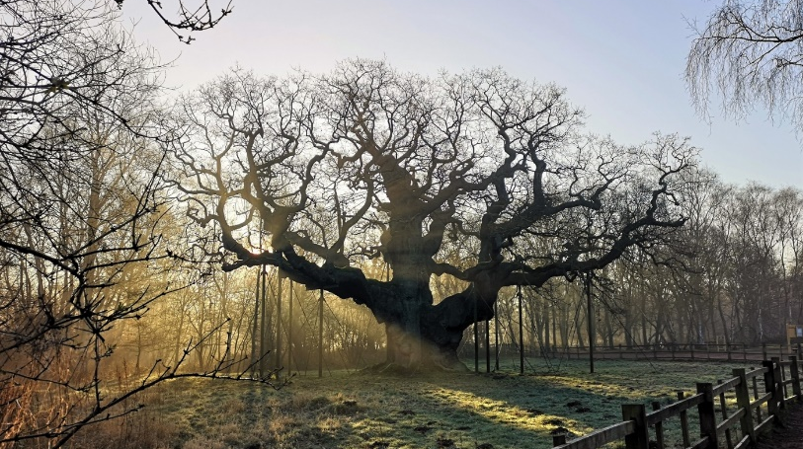
Day Two
08:00 - Arrive at Youth Hostel
Room allocation, unpack, settle in
10:00 – Activities:
Robin Hood walk to Major oak
Habitat Spotting
Mandala Making
Colour Scavenger hunt
12:00 – Lunch – Packed lunches provided
13:00 – Games on field
13:30 – Bus back to school
14:30 – Arrive back at school

Slide 5
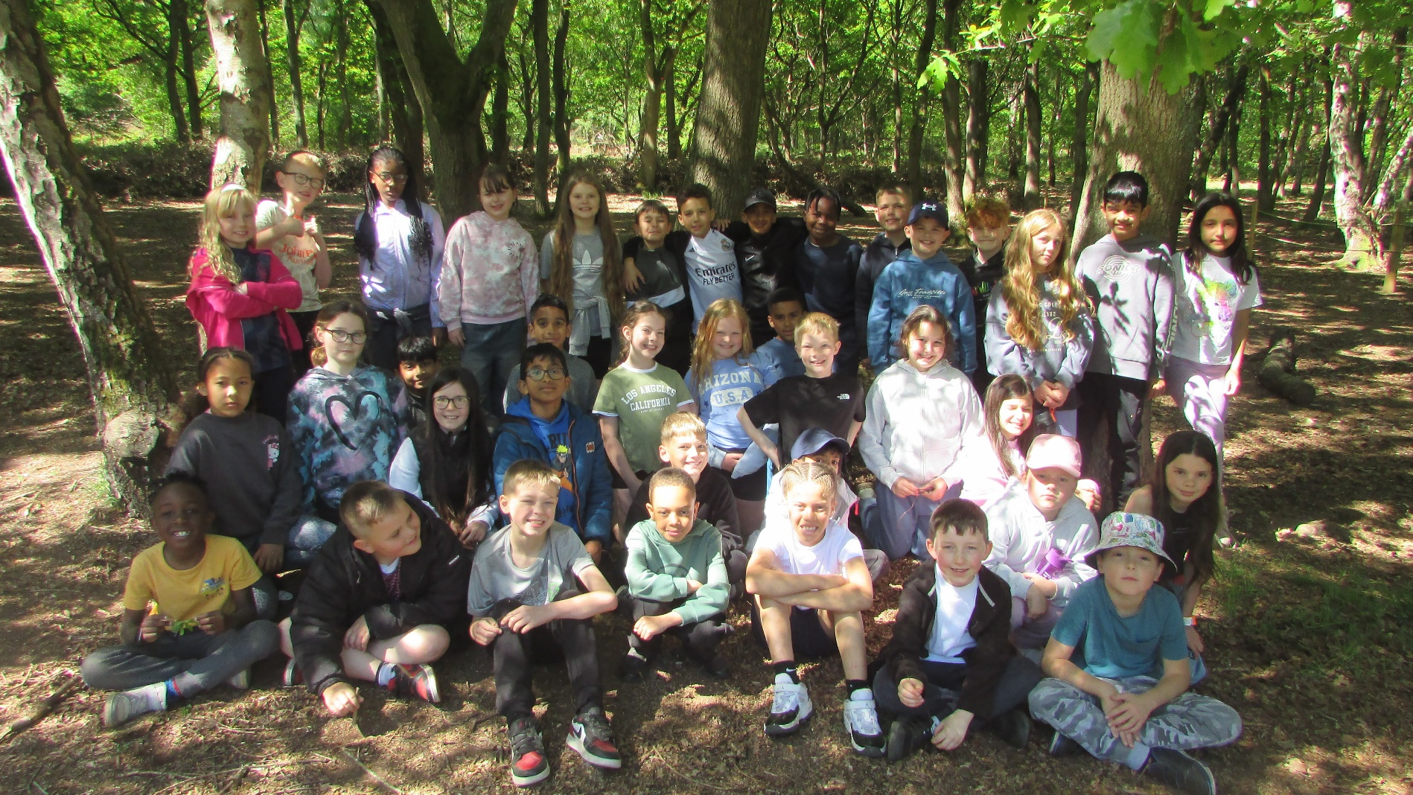
Happy Campers!

Slide 6
Key Information:
Dates: Thurs 7th May – Friday 8th May
Places: 38 – first come, first served
Cost: £87 (less if funding bid successful)
Children will need:
Packed lunch for day 1
1 bag with change of clothes and pajamas, etc.
1 ‘day bag’ with packed lunch, snacks, sun cream etc.
Children are not allowed to bring phones/electronics and will not need any money.

Slide 7

Any Questions?
Further details are included in the handouts and we will make sure we update you with any other news.

