Slide 1

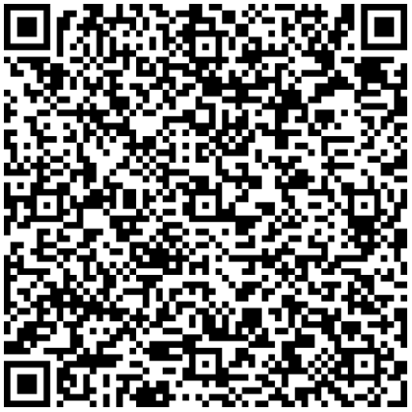
Parents/carers
Thursday 22nd May 2025
5.00-6.30m
For Parents/Carers and families
Nottingham City Autism Team
FREE
Terms and conditions available
on our website:
http://www.eduserve.co.uk/
additional-needs/inclusive-education-service/ies-training
Thursday 22nd May 2025
5.00 – 6.30pm
Click the link or scan the QR code
No booking required – just click or scan to join!
Join the meeting now

