Slide 1
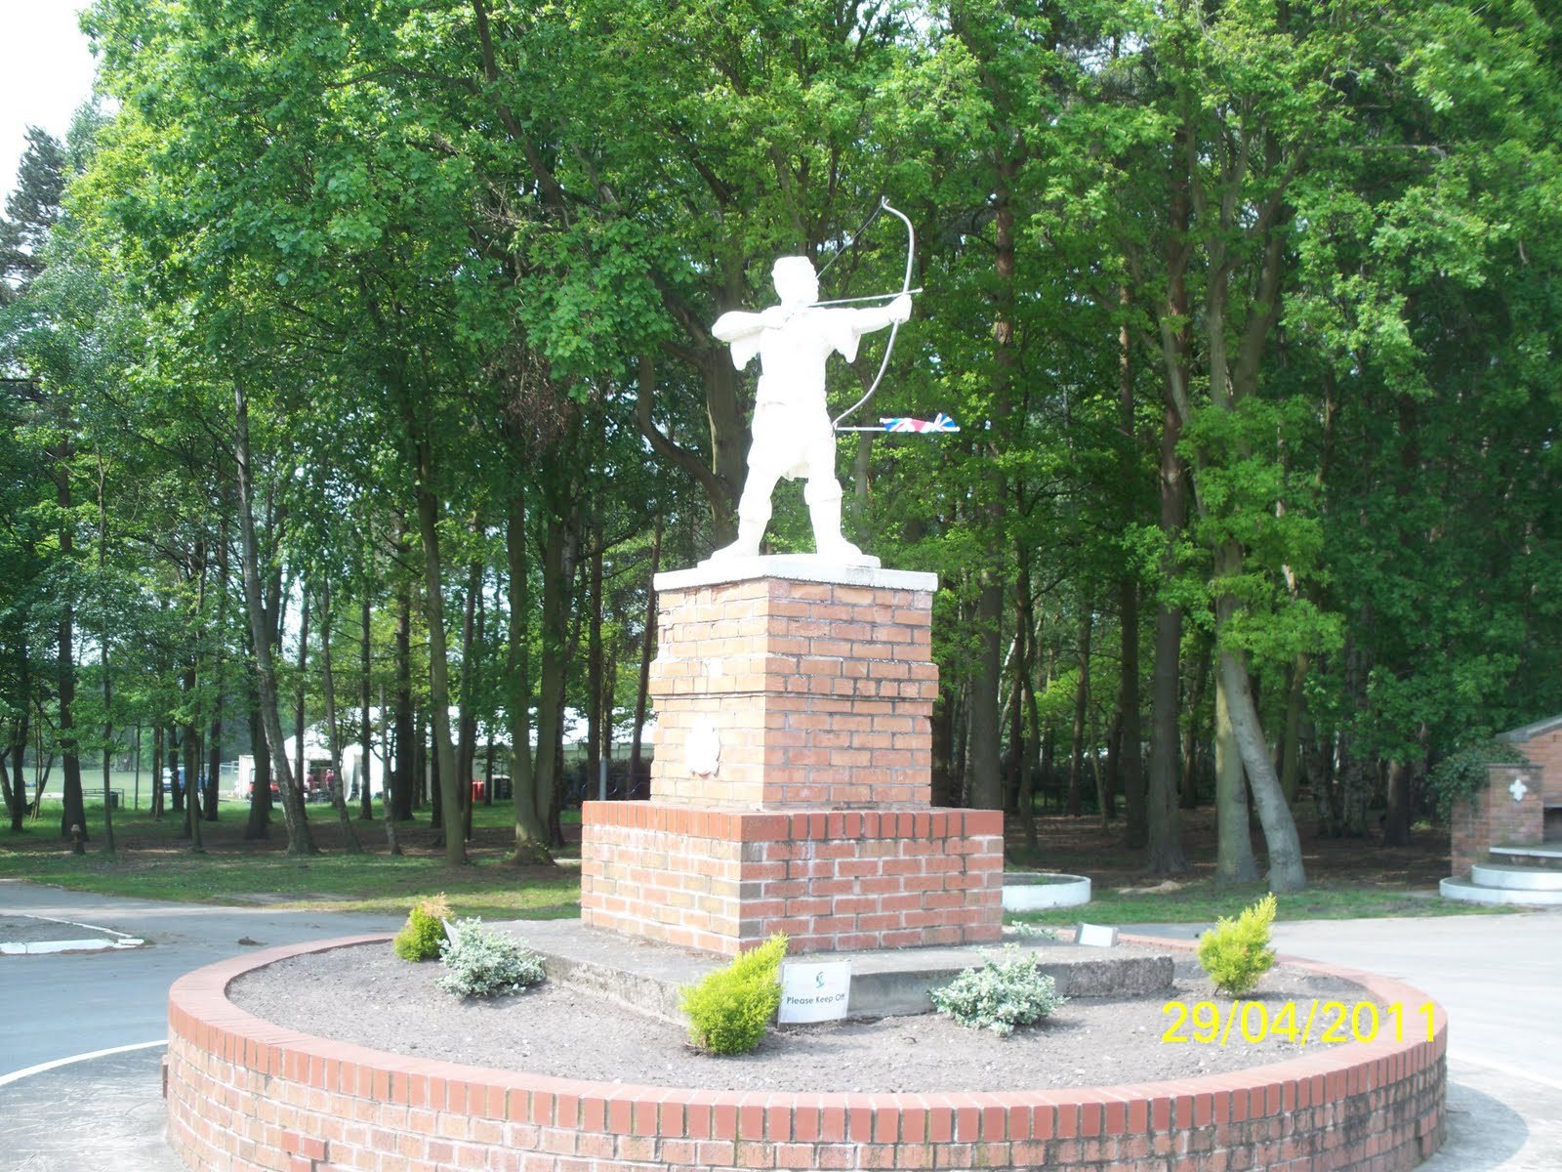
Year 4 - Residential (2020)
Parents Meeting; Tuesday 17th March

Slide 2
General Information
This time, the Year 4 camp will be ran by the staff of Walesby Forest outdoor activity centre.
Similar set up to Year 2 Wollaton Hall camp.
The camp is situated in Walesby Forest, on the outskirts of Newark, about a 40min car journey away from Rise Park. For security reasons it is an enclosed, secure space on privately owned grounds.

Slide 3
General Information
Departure from school:
Wednesday 20th May. Meet 8:55am inside Key Stage 2 hall for 9:30am departure from school by coach.
Arrival back at school:
Thursday 21st May. Children MUST be collected promptly from school, in the KS2 hall at 2:00pm.
Price:
£62.50.
£10 deposit required by Wednesday 25th March.
Price includes food (evening meal, breakfast and packed lunch on day of departure from Walesby), drink, transport, use of equipment and outdoor activities.

Slide 4
Monday | DRAFT Itinerary (weather dependent)
9:30 | Depart school
10:15 – 12.00 | Welcome to camp. Instructions and camp rules. Walk around Walesby Forest grounds
12.00 – 13.00 | Packed lunch (brought from home / school)
 | Children split in to four groups; activities to alternate
14:00 – 15:00 | Activity 1: Indoor climbing / crate stack / archery / wobble pole
15:00 – 15.15 | Break
15.15 – 16.15 | Activity 2: Rotation of activities
16:30 – 19:30 | Dinner (provided by Walesby) / free-time around camp
19.30 – 21.30 | Twilight activity – DISCO!
22:00 | Bed time!

Slide 5
Friday | DRAFT Itinerary (weather dependent)
08.00 – 09.00 | Breakfast (provided by Waleby)
10.00 – 11.00 | Activity 3 – Activities rotate
11.15 – 12.15 | Activity 4 – Activities rotate
 | Packed lunch (provided by Walesby)
12:30 – 1:00
 | Coach back to school
1:15 – 2:00
The itinerary for both days may be subject to changes when we arrive at Walesby Forest activity centre, dependent on either the weather or conditions of the site.
All activities will be run the staff at Walesby with support from school staff at all times.
School staff and qualified first aiders will be present during all activities, and at all times overnight for the duration of the trip.

Slide 6
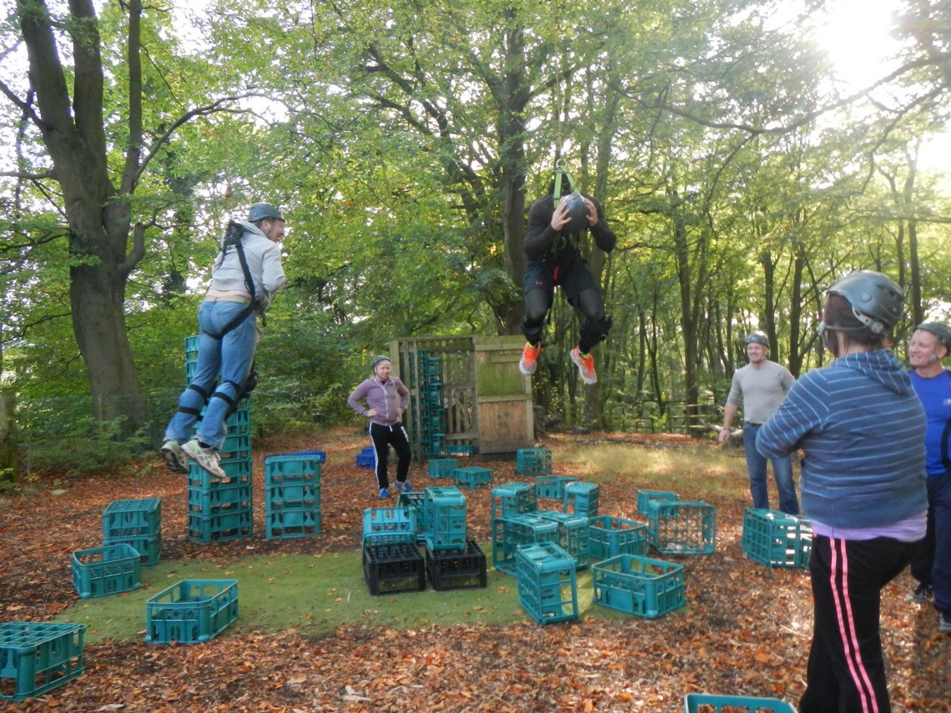
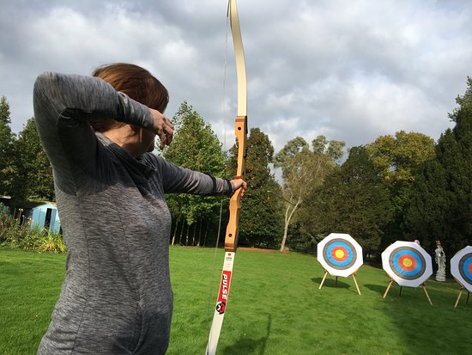
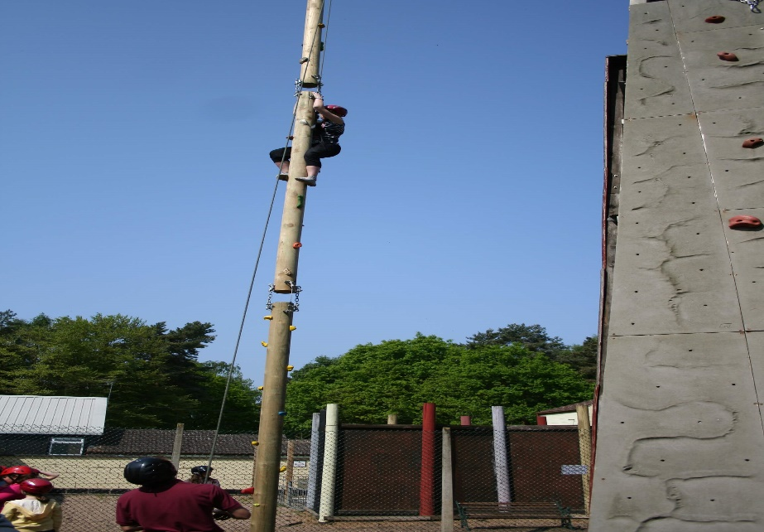
Activities!

Slide 7
Staffing
The camp will be led by experienced members of the Walesby Forest outdoor activity team, with a total of twenty of their staff members working on site at all times.
Miss Keeton, Miss Scholten and Mrs Bell will all be present for every stage of the camp and will be staying overnight. Other members of teaching staff – to be confirmed closer to the time – will also be helping to lead the camp.

Slide 8
Food and Drinks
A hot dinner on Wednesday evening will be provided on-site by Walesby, along with breakfast and a packed lunch on Thursday. The children will need to bring a full packed lunch for Wednesday lunch time and some snacks are advised for the afternoon.
Cold water and juice will be readily available during the whole trip.
We recommend all children bring a plastic bottle of water and keep it for water top-ups. The children will be able to carry this with them throughout the day.

Slide 9
Sleeping
Children will be allocated by staff to single gender tents in groups of four. All tents will be in very close proximity to one another, in a loose horseshoe shape.
Staff tents will be made obvious to the children, and they will be located in the same location.
Children will need to bring their own roll mat, sleeping bag and pillow.
Children will need to tidy away their belongings and ensure their tent is cleaned before departure.

Slide 10
Toilets
Children will have full access to toilets and will be shown how to use them properly on arrival. There may be other school groups using these facilities during the day, so staff will monitor the children if they are using them.
As well as toilets, there are full washing facilities, so the children will be able to get cleaned up and have their teeth brushed ready for an early night!

Slide 11
Packing List
Sensible bag – rucksack, backpack – NOT a suitcase!!
Nothing too big as children will need to carry their own bag to campsite from bus drop off point. No suitcases as they take up too much room in the tent and will not be able to be rolled across wet grass. We recommend a sports bag or rucksack.
Pillow
Sleeping bag
Roll mat / camping mat
Cuddly toy
Clothes
We recommend three sets of clothes. One to go in, one to sleep in (which can be used as an emergency back up) and one change of clothing. Due to the English weather, these clothes need to be warm. No jeans! The children may wish to bring a change of clothes for the evening disco, but this is NOT compulsory.
Waterproof coat
Hat/Gloves

Slide 12
Packing List - continued
Trainers – OLD; don’t pack anything new!
Wellington boots
The grass around camp will be very wet, especially in the mornings. (Alternative option can be another pair of trainers / walking boots)
Sun hat
Sun cream
Water bottle
Black bin liners (3?)
Especially if bad weather predicted. Good to pack pillow etc in to keep them clean and dry. Also good for dirty washing.
Small hand towel
Toothbrush and paste
Any other wash / hair kit if needed

Slide 13
Packing List - continued
Snacks
Needs to be small, light and securely packed. No eating on bus or in tents. No fizzy drinks.
Torch
Optional. Don’t buy one.
PLEASE LABEL ALL CLOTHING
NO electronic equipment, mobile phones, etc.
NO expensive designer clothes or inappropriate footwear.

Slide 14
Any Questions?

Slide 15
What Next?
Unfortunately, there are only 40 places available for the residential / camp this year.
Please can you speak to a member of teaching staff at the end of the meeting to express your interest in sending your child on the residential / camping trip.
If we have more than 40 children’s names, we will have to select children at random to attend the camp until all places have been allocated.

Slide 16
What Next?
Once the 40 children have been selected, we will send out confirmation letters for the trip by the start of next week.
The school will then require prompt payment of the £10 deposit; details regarding this will be sent with the confirmation letters. The balance for the trip must then be paid in full a week before we leave for camp.
Please be aware, if your child is chosen but their behaviour in school deteriorates between now and the date of the trip, their place on the residential will be forfeited due to health and safety regulations.

